Slide 1
Monali Rajaram Kumbhar SQL project
Grocery Store Management

Slide 2
Objectives
The main goals of this SQL project are:
● To design and implement a relational database for a grocery store.
● To retrieve and manipulate data using SQL queries.
● To perform data analysis for business insights such as top customers, best-
selling products, and revenue trends.
● To practice using joins, aggregations, subqueries, and filtering techniques.

Slide 3
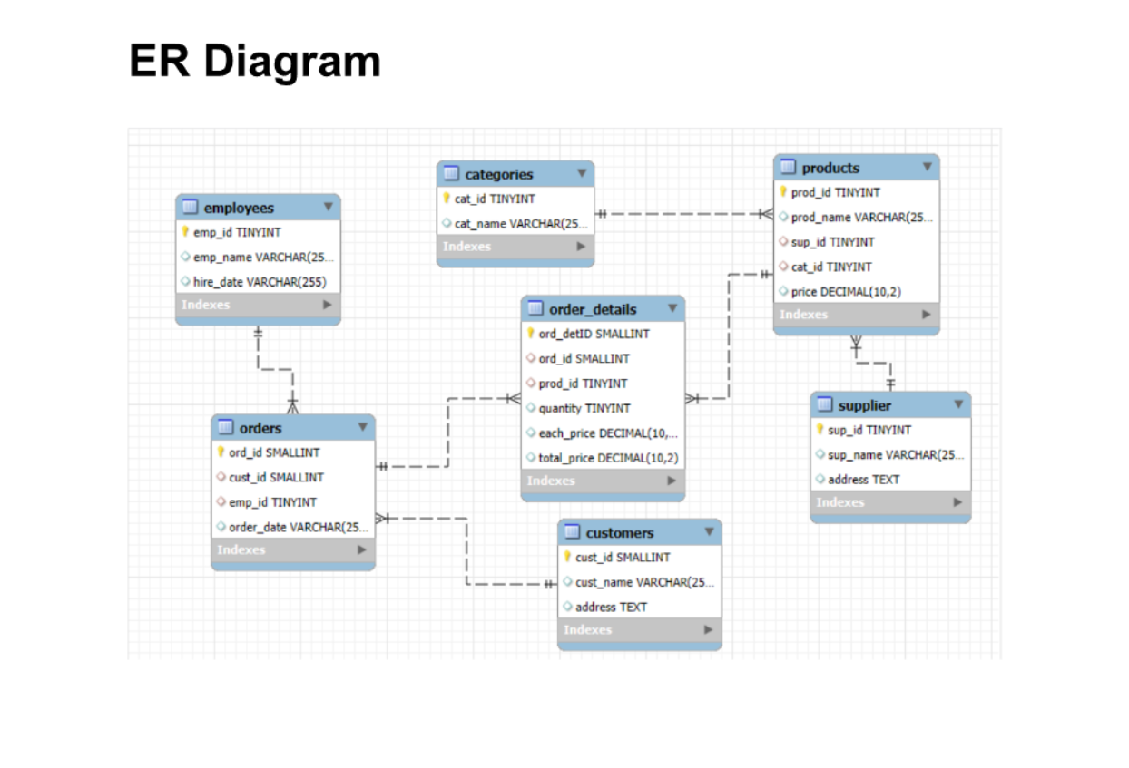

Slide 4
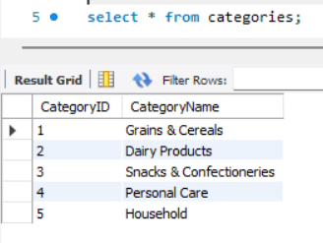
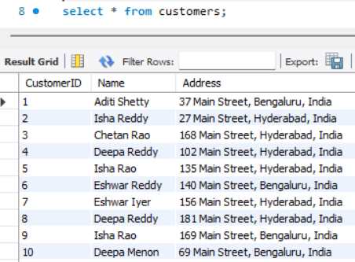
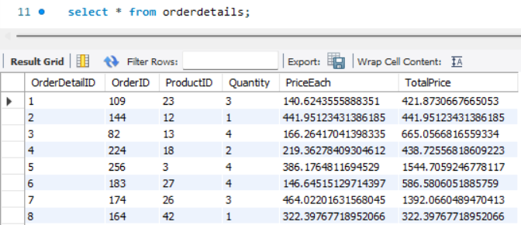
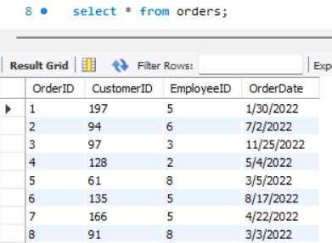
Tables
Categories
customers
Order details
orders

Slide 5
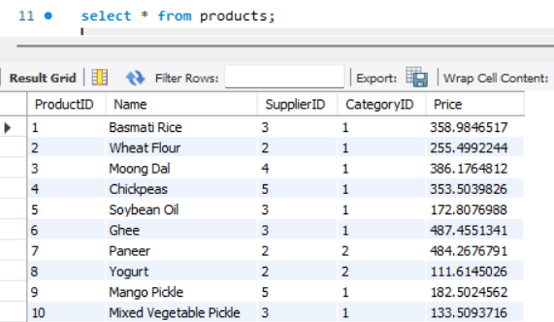
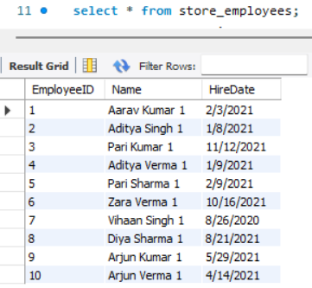
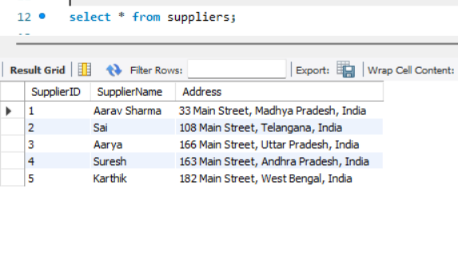
Tables
Products
employees
Suppliers

Slide 6
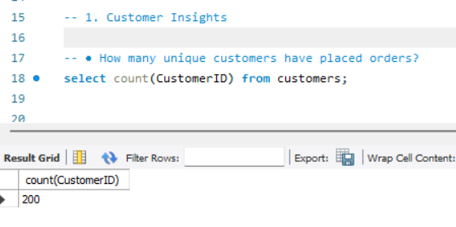
How many unique customers have placed orders??

Slide 7
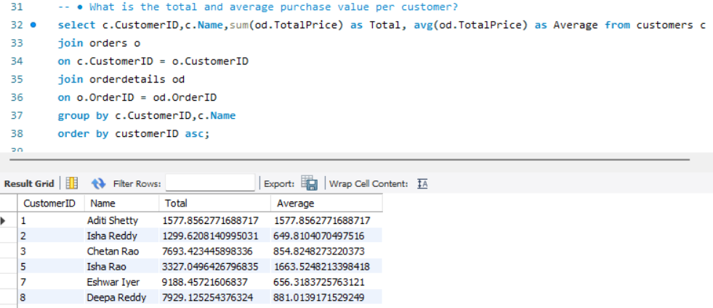
What is the total and average purchase value per customer?

Slide 8
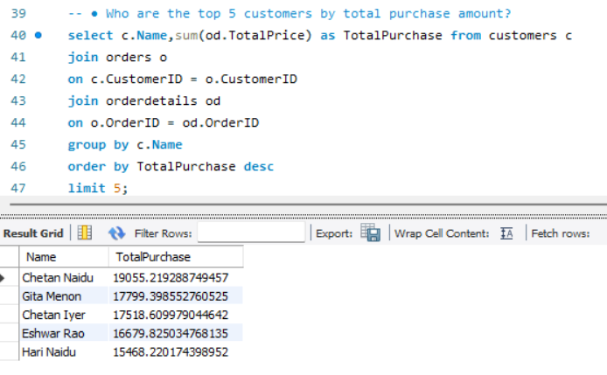
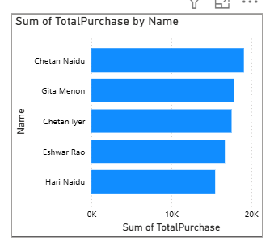
Who are the top 5 customers by total purchase amount?

Slide 9
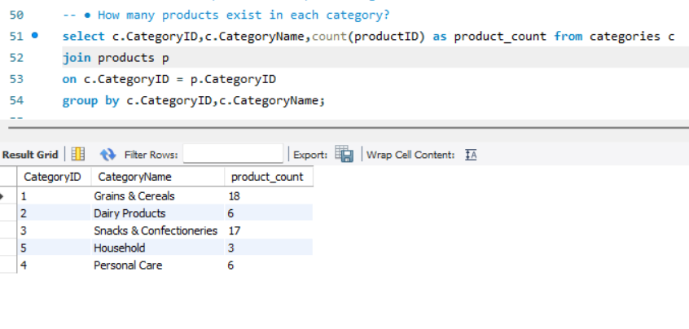
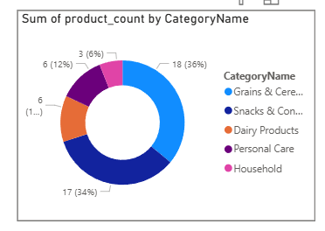
How many products exist in each category

Slide 10
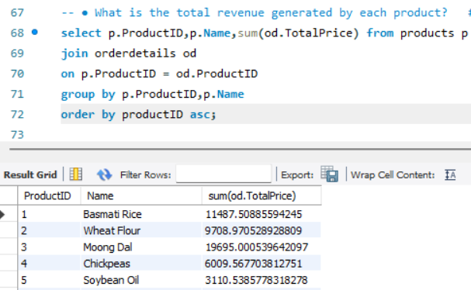
What is the total revenue generated by each product

Slide 11
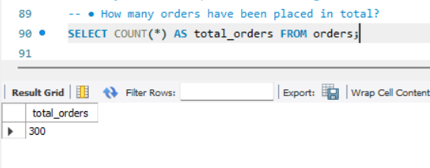
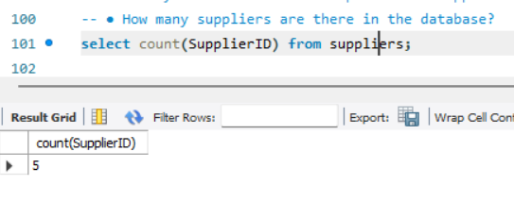
How many orders have
been placed in total
How many suppliers
are there in the database

Slide 12
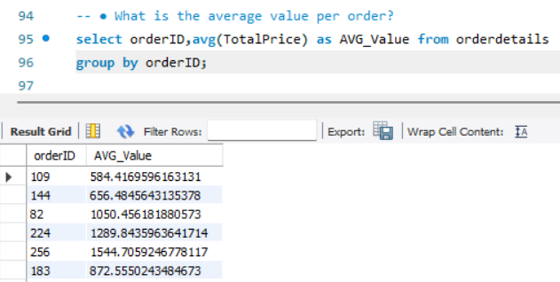
What is the average value per order

Slide 13
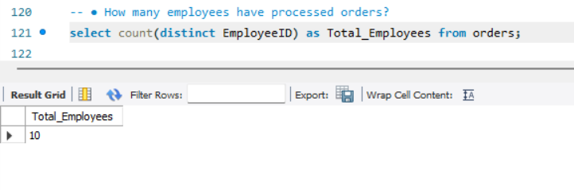
How many employee have processed orders

Slide 14
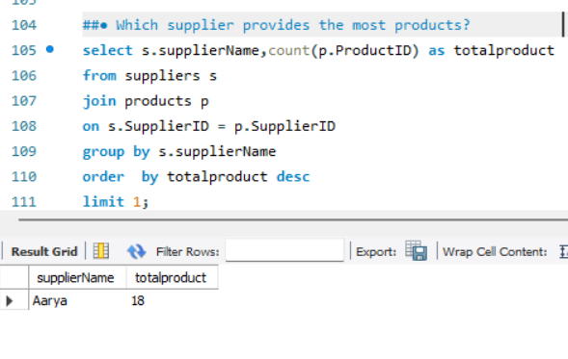
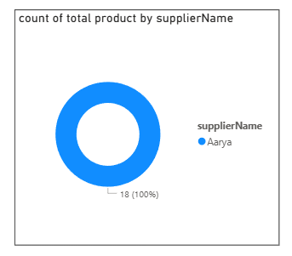
Which supplier provide the most products

Slide 15
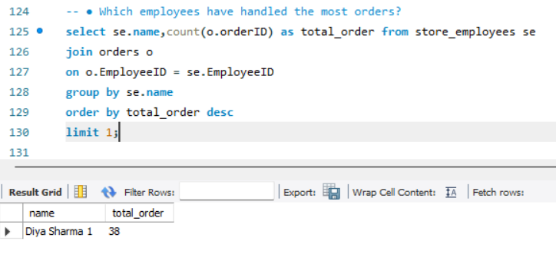
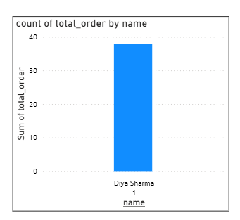
Which employee have handled the most orders

Slide 16
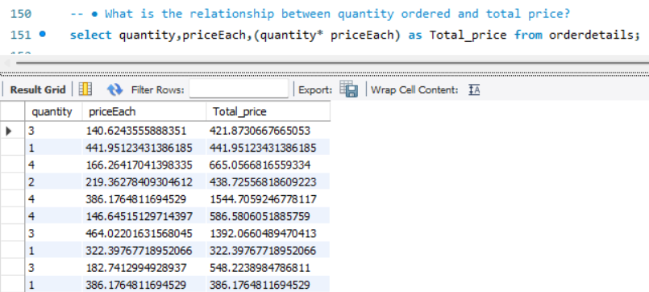
What is the relationship between quantity ordered and total price

Slide 17
THANK YOU!!!!

